Slide 1

Lecture 5
Data Independence
Dr. Sanjeev Kumar
Asst. Professor

Slide 2
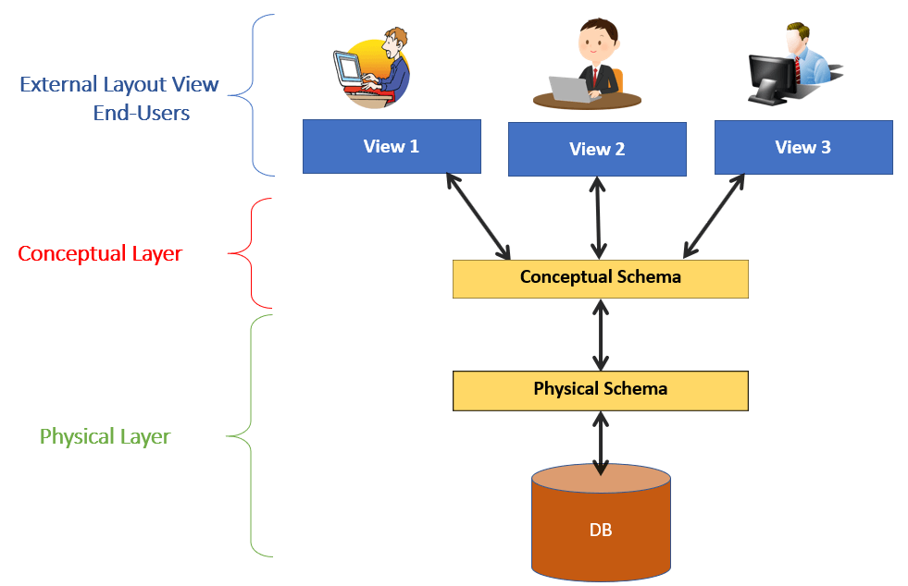
Three level DBMS Architecture Model

Slide 3
External or View level
It is the users’ view of the database. This level describes that part of the database that is relevant to each user.
For example, one user may view dates in the form (day, month, year), while another may view dates as (year, month, day).

Slide 4
Conceptual or logical level
It is the community view of the database. This level describes what data is stored in the database and the relationships among the data.
It represents:
All entities, their attributes, and their relationships;
The constraints on the data;
Security and integrity information

Slide 5
Internal or storage level
It is the physical representation of the database on the computer. This level describes how the data is stored in the database.

Slide 6
Data Independence
The capacity to change schema at one level without having change in next level.
Data independence helps you to keep data separated from all programs that make use of it.
We have to changes because the size of database increases day by day.

Slide 7
Types of Data Independence
Logical Data Independence
Physical Data Independence

Slide 8
Logical Data Independence
The ability to change the logical schema without changing the external schema or application programs is called as logical data independence.

Slide 9
Physical Data Independence
Physical data independence can be defined as the capacity to change the internal schema without having to change the conceptual schema.
If we do any changes in the storage size of the database system server, then the Conceptual structure of the database will not be affected.

Slide 10
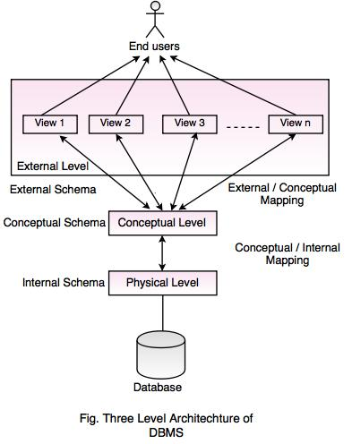

Slide 11
7 12
Processing
3 + 4
3 * 4

Slide 12
Thank You

